Slide 1
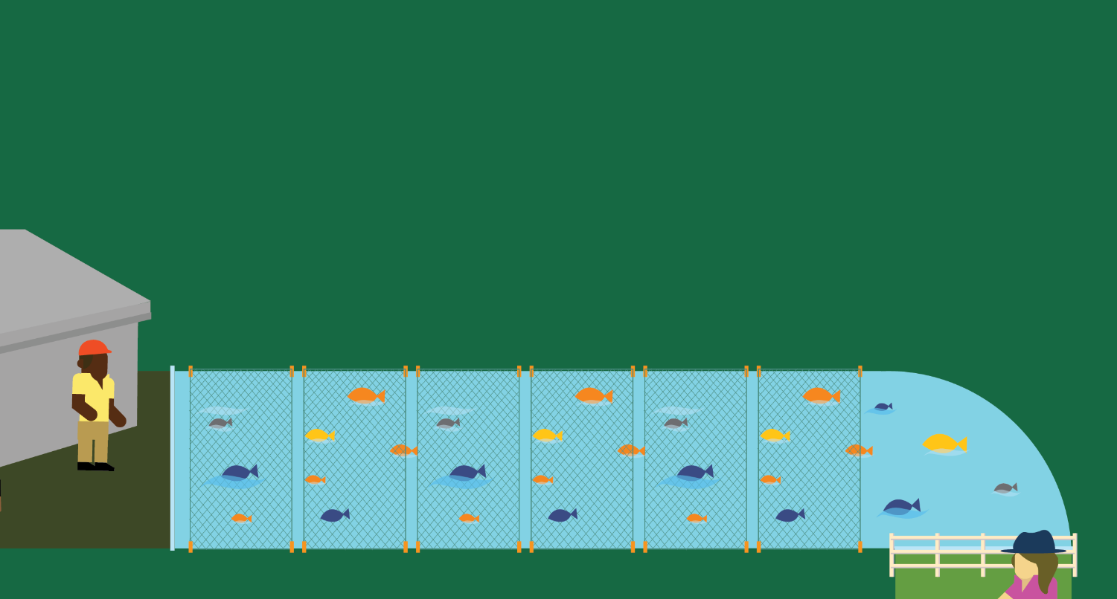
Lesson 3
Seafood: Wild and Farmed
© 2020 Johns Hopkins University

Slide 2
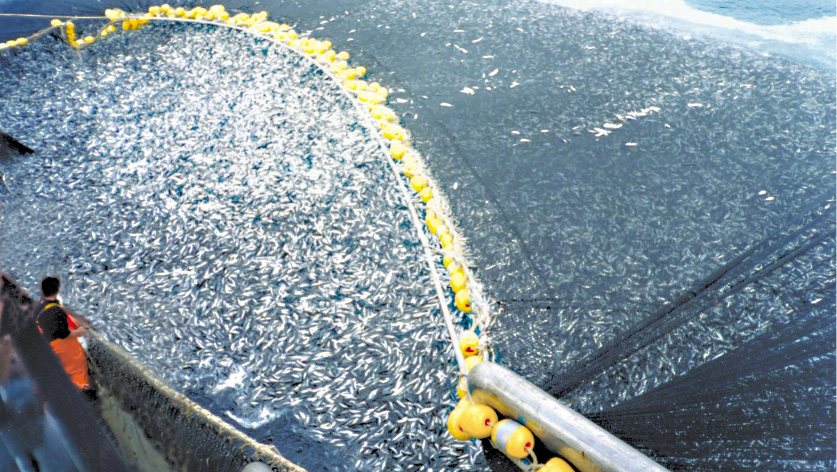
Seafood Production
About 400 tons of mackerel caught in a purse seine (a type of net) in Chile.
Most global seafood harvests use gigantic nets that are pulled through the water or along the sea floor.
Photo credit: C. Ortiz Rojas, 1997. NOAA Photo Library.

Slide 3
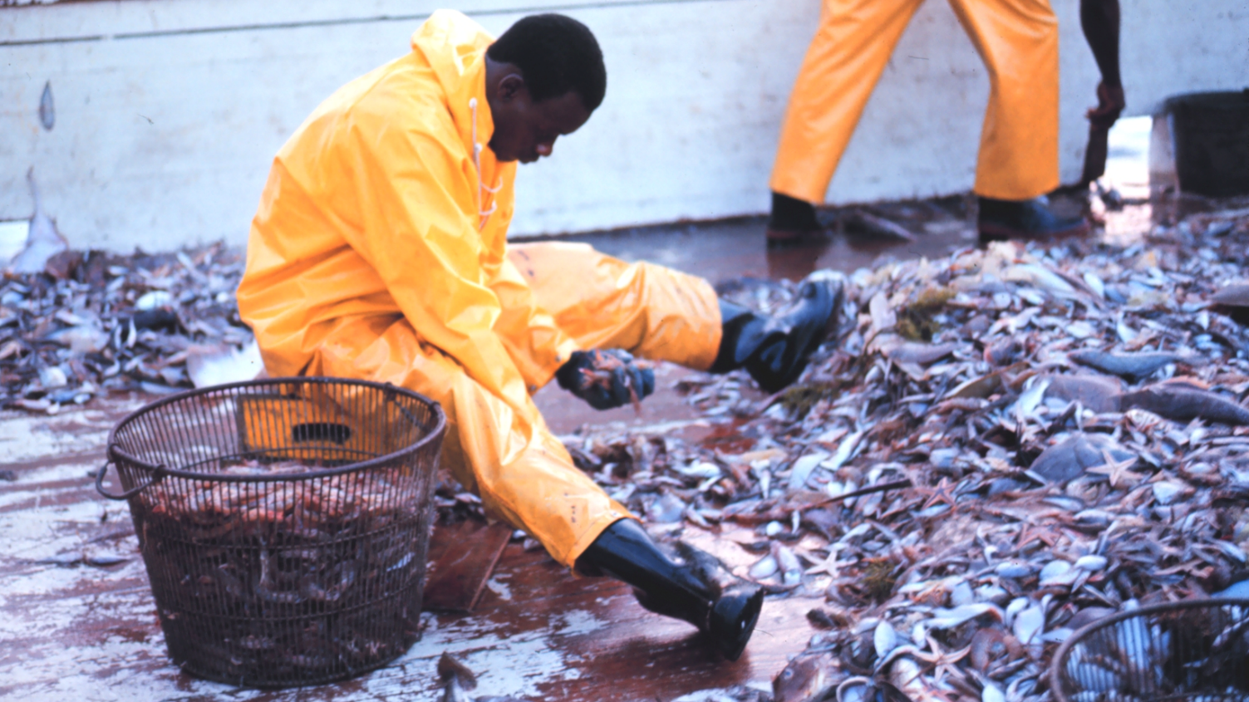
Seafood Production-Bycatch
Separating shrimp from bycatch (non-target species caught unintentionally).
In the shrimp harvesting industry, only 5 percent of what some trawlers catch is actually shrimp, and the rest is bycatch.
Source: Davies RWD, Cripps SJ, et al. Defining and estimating global marine fisheries bycatch. Mar. Policy 2009;33(4):661-672.
Photo credit: National Oceanic & Atmospheric Adminstration, 1969. NOAA Photo Library.

Slide 4
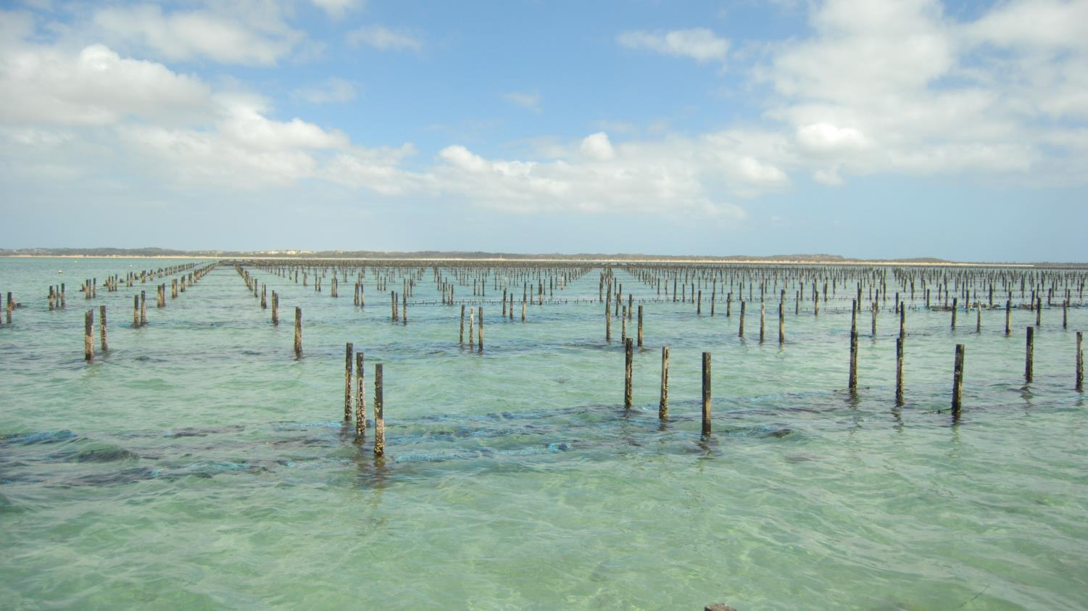
Seafood Production- Oyster Farm
On this Australian farm, oysters are raised in submerged bags attached to poles.
Photo credit: Saoysters, 2009. Wikimedia Commons. Creative Commons CC BY 3.0. https://creativecommons.org/licenses/by/3.0/deed.en

Slide 5
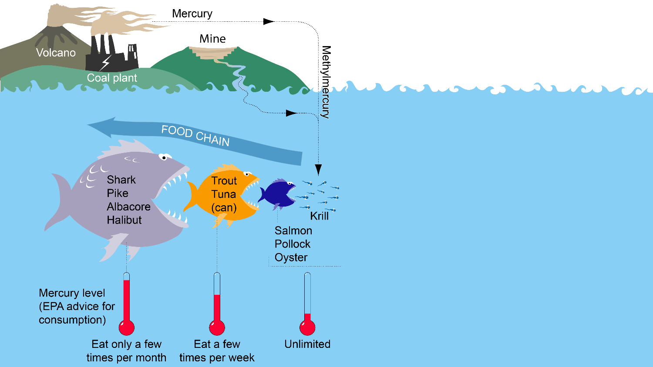
Seafood Safety
These guidelines are designed to protect children and pregnant women.
Source: U.S. Environmental Protection Agency.
Image credit: Bretwood Higman, 2009. Creative Commons CC BY 3.0. https://creativecommons.org/licenses/by/3.0/deed.en

